Slide 1
Topic Modeling on News Articles
Topic Modeling on News Articles
Manoj Kumar

Slide 2
Topics for discussion
Data Description
Problem Description
Topic Modeling on News Articles using spacy
Topic Modeling on News Articles Using NLTK_Gensim
conclusion

Slide 3
Data Description:
The dataset contains a set of news articles for each major segment consisting of business, entertainment, politics, sports and technology. You need to create an aggregate dataset of all the news articles and perform topic modeling on this dataset. Verify whether these topics correspond to the different tags available.

Slide 4
Problem Description
In this project your task is to identify major themes/topics across a collection of BBC news articles. You can use clustering algorithms such as Latent Dirichlet Allocation (LDA), Latent Semantic Analysis (LSA) etc.

Slide 5
Topic Modeling on News Articles using spacy

Slide 6
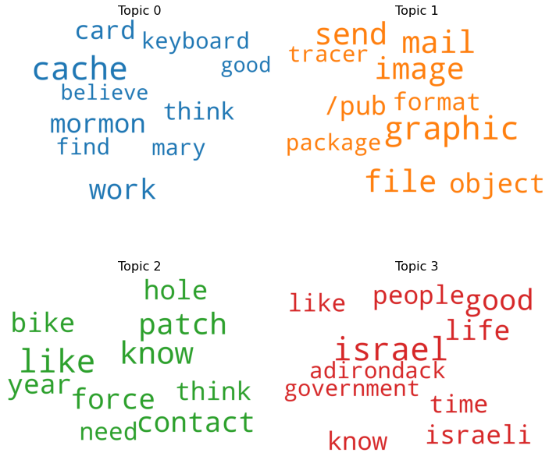
Word cloud after applying spacy
First we will load the dataset and after that we load spacy and we Create Corpus using Bag of words and represent it in bag of words

Slide 7
Topic Modeling on News Articles Using NLTK_Gensim

Slide 8
Loading the data
document
0 Well i'm not sure about the story nad it did s...
1 \n\n\n\n\n\n\nYeah, do you expect people to re...
2 Although I realize that principle is not one o...
3 Notwithstanding all the legitimate fuss about ...
4 Well, I will have to change the scoring on my ...

Slide 9
Clean the Data
0 well sure about story seem biased what disagre...
1 yeah expect people read actually accept hard a...
2 although realize that principle your strongest...
3 notwithstanding legitimate fuss about this pro...
4 well will have change scoring playoff pool unf... ...
95 follow mark last posting current investigation...
96 could folk song clementine memory serves part ...
97 first chip doesn that runs megabits second whi...
98 created image gaea therefore must pinnacle cre...
99 sale pontiac grand prix white white rims gray ...
Name: document, Length: 100, dtype: object
Transforming text into something an algorithm can digest it a complicated process. We cannot feed the data as it is, some preprocessing needs to be done. In this task we will be doing some preprocessing to convert our data in a form that we can feed our model with.

Slide 10
Handling the Stop-words
0 well sure story seem biased disagree statement...
1 yeah expect people read actually accept hard a...
2 although realize principle strongest points wo...
3 notwithstanding legitimate fuss proposal much ...
4 well change scoring playoff pool unfortunately... ...
95 follow mark last posting current investigation...
96 could folk song clementine memory serves part ...
97 first chip runs megabits second beyond need vo...
98 created image gaea therefore must pinnacle cre...
99 sale pontiac grand prix white white rims gray ...
Name: document, Length: 100, dtype: object
Text may contain stop words like ‘the’, ‘is’, ‘are’. Stop words can be filtered from the text to be processed. There is no universal list of stop words in nlp research, however the nltk module contains a list of stop words. We will remove these stopwords in this task.

Slide 11
Lemmatization
0 well sure story seem biased disagree statement...
1 yeah expect people read actually accept hard a...
2 although realize principle strongest point wou...
3 notwithstanding legitimate fuss proposal much ...
4 well change scoring playoff pool unfortunately... ...
95 follow mark last posting current investigation...
96 could folk song clementine memory serf part go...
97 first chip run megabit second beyond need voic...
98 created image gaea therefore must pinnacle cre...
99 sale pontiac grand prix white white rim gray i...
Name: document, Length: 100, dtype: object
Lemmatization is the process of grouping together the different inflected forms of a word so they can be analyzed as a single item. Lemmatization is similar to stemming but it brings context to the words. So it links words with similar meanings to one word.

Slide 12
TF-IDF Vectorization
Apart from Count vectorizer an alternative to calculate word frequencies , and by far the most popular method is called TF-IDF. This is an acronym than stands for “Term Frequency – Inverse Document” Frequency which are the components of the resulting scores assigned to each word.

Slide 13
0 | 1 | 2 | 3 | 4 | 5 | 6 | 7 | 8 | 9 | 10 | 11 | 12 | 13 | 14 | 15 | 16 | 17 | 18 | 19 | 20 | 21 | 22 | 23 | 24 | 25 | 26 | 27 | 28 | 29 | 30 | 31 | 32 | 33 | 34 | 35 | 36 | 37 | 38 | 39 | ... | 960 | 961 | 962 | 963 | 964 | 965 | 966 | 967 | 968 | 969 | 970 | 971 | 972 | 973 | 974 | 975 | 976 | 977 | 978 | 979 | 980 | 981 | 982 | 983 | 984 | 985 | 986 | 987 | 988 | 989 | 990 | 991 | 992 | 993 | 994 | 995 | 996 | 997 | 998 | 999
0 | 0.0 | 0.0 | 0.0 | 0.000000 | 0.0 | 0.0 | 0.0 | 0.000000 | 0.0 | 0.0 | 0.0 | 0.0 | 0.0 | 0.0 | 0.0 | 0.0 | 0.0 | 0.0 | 0.0 | 0.0 | 0.0 | 0.0 | 0.0 | 0.000000 | 0.0 | 0.0 | 0.0 | 0.0 | 0.0 | 0.0 | 0.0 | 0.00000 | 0.0 | 0.0 | 0.0 | 0.0 | 0.000000 | 0.0 | 0.0 | 0.0 | ... | 0.0 | 0.0 | 0.0 | 0.0 | 0.0 | 0.000000 | 0.0 | 0.0 | 0.0 | 0.0 | 0.0 | 0.0000 | 0.0 | 0.0 | 0.0 | 0.000000 | 0.0 | 0.0 | 0.0 | 0.0 | 0.000000 | 0.0 | 0.00000 | 0.0 | 0.0 | 0.132214 | 0.0 | 0.0 | 0.000000 | 0.0 | 0.0 | 0.0 | 0.0 | 0.0 | 0.0 | 0.000000 | 0.00000 | 0.0 | 0.0 | 0.0
1 | 0.0 | 0.0 | 0.0 | 0.196228 | 0.0 | 0.0 | 0.0 | 0.167434 | 0.0 | 0.0 | 0.0 | 0.0 | 0.0 | 0.0 | 0.0 | 0.0 | 0.0 | 0.0 | 0.0 | 0.0 | 0.0 | 0.0 | 0.0 | 0.000000 | 0.0 | 0.0 | 0.0 | 0.0 | 0.0 | 0.0 | 0.0 | 0.00000 | 0.0 | 0.0 | 0.0 | 0.0 | 0.000000 | 0.0 | 0.0 | 0.0 | ... | 0.0 | 0.0 | 0.0 | 0.0 | 0.0 | 0.000000 | 0.0 | 0.0 | 0.0 | 0.0 | 0.0 | 0.0000 | 0.0 | 0.0 | 0.0 | 0.000000 | 0.0 | 0.0 | 0.0 | 0.0 | 0.000000 | 0.0 | 0.00000 | 0.0 | 0.0 | 0.000000 | 0.0 | 0.0 | 0.000000 | 0.0 | 0.0 | 0.0 | 0.0 | 0.0 | 0.0 | 0.000000 | 0.00000 | 0.0 | 0.0 | 0.0
2 | 0.0 | 0.0 | 0.0 | 0.000000 | 0.0 | 0.0 | 0.0 | 0.000000 | 0.0 | 0.0 | 0.0 | 0.0 | 0.0 | 0.0 | 0.0 | 0.0 | 0.0 | 0.0 | 0.0 | 0.0 | 0.0 | 0.0 | 0.0 | 0.000000 | 0.0 | 0.0 | 0.0 | 0.0 | 0.0 | 0.0 | 0.0 | 0.00000 | 0.0 | 0.0 | 0.0 | 0.0 | 0.444331 | 0.0 | 0.0 | 0.0 | ... | 0.0 | 0.0 | 0.0 | 0.0 | 0.0 | 0.097594 | 0.0 | 0.0 | 0.0 | 0.0 | 0.0 | 0.0000 | 0.0 | 0.0 | 0.0 | 0.000000 | 0.0 | 0.0 | 0.0 | 0.0 | 0.000000 | 0.0 | 0.08758 | 0.0 | 0.0 | 0.000000 | 0.0 | 0.0 | 0.000000 | 0.0 | 0.0 | 0.0 | 0.0 | 0.0 | 0.0 | 0.000000 | 0.00000 | 0.0 | 0.0 | 0.0
3 | 0.0 | 0.0 | 0.0 | 0.000000 | 0.0 | 0.0 | 0.0 | 0.000000 | 0.0 | 0.0 | 0.0 | 0.0 | 0.0 | 0.0 | 0.0 | 0.0 | 0.0 | 0.0 | 0.0 | 0.0 | 0.0 | 0.0 | 0.0 | 0.000000 | 0.0 | 0.0 | 0.0 | 0.0 | 0.0 | 0.0 | 0.0 | 0.00000 | 0.0 | 0.0 | 0.0 | 0.0 | 0.000000 | 0.0 | 0.0 | 0.0 | ... | 0.0 | 0.0 | 0.0 | 0.0 | 0.0 | 0.000000 | 0.0 | 0.0 | 0.0 | 0.0 | 0.0 | 0.0000 | 0.0 | 0.0 | 0.0 | 0.000000 | 0.0 | 0.0 | 0.0 | 0.0 | 0.000000 | 0.0 | 0.00000 | 0.0 | 0.0 | 0.000000 | 0.0 | 0.0 | 0.000000 | 0.0 | 0.0 | 0.0 | 0.0 | 0.0 | 0.0 | 0.126337 | 0.00000 | 0.0 | 0.0 | 0.0
4 | 0.0 | 0.0 | 0.0 | 0.000000 | 0.0 | 0.0 | 0.0 | 0.000000 | 0.0 | 0.0 | 0.0 | 0.0 | 0.0 | 0.0 | 0.0 | 0.0 | 0.0 | 0.0 | 0.0 | 0.0 | 0.0 | 0.0 | 0.0 | 0.000000 | 0.0 | 0.0 | 0.0 | 0.0 | 0.0 | 0.0 | 0.0 | 0.00000 | 0.0 | 0.0 | 0.0 | 0.0 | 0.000000 | 0.0 | 0.0 | 0.0 | ... | 0.0 | 0.0 | 0.0 | 0.0 | 0.0 | 0.000000 | 0.0 | 0.0 | 0.0 | 0.0 | 0.0 | 0.0000 | 0.0 | 0.0 | 0.0 | 0.000000 | 0.0 | 0.0 | 0.0 | 0.0 | 0.000000 | 0.0 | 0.00000 | 0.0 | 0.0 | 0.000000 | 0.0 | 0.0 | 0.000000 | 0.0 | 0.0 | 0.0 | 0.0 | 0.0 | 0.0 | 0.000000 | 0.00000 | 0.0 | 0.0 | 0.0
... | ... | ... | ... | ... | ... | ... | ... | ... | ... | ... | ... | ... | ... | ... | ... | ... | ... | ... | ... | ... | ... | ... | ... | ... | ... | ... | ... | ... | ... | ... | ... | ... | ... | ... | ... | ... | ... | ... | ... | ... | ... | ... | ... | ... | ... | ... | ... | ... | ... | ... | ... | ... | ... | ... | ... | ... | ... | ... | ... | ... | ... | ... | ... | ... | ... | ... | ... | ... | ... | ... | ... | ... | ... | ... | ... | ... | ... | ... | ... | ... | ...
95 | 0.0 | 0.0 | 0.0 | 0.000000 | 0.0 | 0.0 | 0.0 | 0.000000 | 0.0 | 0.0 | 0.0 | 0.0 | 0.0 | 0.0 | 0.0 | 0.0 | 0.0 | 0.0 | 0.0 | 0.0 | 0.0 | 0.0 | 0.0 | 0.164241 | 0.0 | 0.0 | 0.0 | 0.0 | 0.0 | 0.0 | 0.0 | 0.17339 | 0.0 | 0.0 | 0.0 | 0.0 | 0.000000 | 0.0 | 0.0 | 0.0 | ... | 0.0 | 0.0 | 0.0 | 0.0 | 0.0 | 0.000000 | 0.0 | 0.0 | 0.0 | 0.0 | 0.0 | 0.0000 | 0.0 | 0.0 | 0.0 | 0.000000 | 0.0 | 0.0 | 0.0 | 0.0 | 0.000000 | 0.0 | 0.00000 | 0.0 | 0.0 | 0.000000 | 0.0 | 0.0 | 0.164241 | 0.0 | 0.0 | 0.0 | 0.0 | 0.0 | 0.0 | 0.000000 | 0.17339 | 0.0 | 0.0 | 0.0
96 | 0.0 | 0.0 | 0.0 | 0.000000 | 0.0 | 0.0 | 0.0 | 0.000000 | 0.0 | 0.0 | 0.0 | 0.0 | 0.0 | 0.0 | 0.0 | 0.0 | 0.0 | 0.0 | 0.0 | 0.0 | 0.0 | 0.0 | 0.0 | 0.000000 | 0.0 | 0.0 | 0.0 | 0.0 | 0.0 | 0.0 | 0.0 | 0.00000 | 0.0 | 0.0 | 0.0 | 0.0 | 0.000000 | 0.0 | 0.0 | 0.0 | ... | 0.0 | 0.0 | 0.0 | 0.0 | 0.0 | 0.000000 | 0.0 | 0.0 | 0.0 | 0.0 | 0.0 | 0.0000 | 0.0 | 0.0 | 0.0 | 0.000000 | 0.0 | 0.0 | 0.0 | 0.0 | 0.000000 | 0.0 | 0.00000 | 0.0 | 0.0 | 0.000000 | 0.0 | 0.0 | 0.000000 | 0.0 | 0.0 | 0.0 | 0.0 | 0.0 | 0.0 | 0.000000 | 0.00000 | 0.0 | 0.0 | 0.0
97 | 0.0 | 0.0 | 0.0 | 0.000000 | 0.0 | 0.0 | 0.0 | 0.000000 | 0.0 | 0.0 | 0.0 | 0.0 | 0.0 | 0.0 | 0.0 | 0.0 | 0.0 | 0.0 | 0.0 | 0.0 | 0.0 | 0.0 | 0.0 | 0.000000 | 0.0 | 0.0 | 0.0 | 0.0 | 0.0 | 0.0 | 0.0 | 0.00000 | 0.0 | 0.0 | 0.0 | 0.0 | 0.000000 | 0.0 | 0.0 | 0.0 | ... | 0.0 | 0.0 | 0.0 | 0.0 | 0.0 | 0.000000 | 0.0 | 0.0 | 0.0 | 0.0 | 0.0 | 0.0000 | 0.0 | 0.0 | 0.0 | 0.000000 | 0.0 | 0.0 | 0.0 | 0.0 | 0.000000 | 0.0 | 0.00000 | 0.0 | 0.0 | 0.000000 | 0.0 | 0.0 | 0.000000 | 0.0 | 0.0 | 0.0 | 0.0 | 0.0 | 0.0 | 0.122917 | 0.00000 | 0.0 | 0.0 | 0.0
98 | 0.0 | 0.0 | 0.0 | 0.000000 | 0.0 | 0.0 | 0.0 | 0.000000 | 0.0 | 0.0 | 0.0 | 0.0 | 0.0 | 0.0 | 0.0 | 0.0 | 0.0 | 0.0 | 0.0 | 0.0 | 0.0 | 0.0 | 0.0 | 0.000000 | 0.0 | 0.0 | 0.0 | 0.0 | 0.0 | 0.0 | 0.0 | 0.00000 | 0.0 | 0.0 | 0.0 | 0.0 | 0.000000 | 0.0 | 0.0 | 0.0 | ... | 0.0 | 0.0 | 0.0 | 0.0 | 0.0 | 0.000000 | 0.0 | 0.0 | 0.0 | 0.0 | 0.0 | 0.0000 | 0.0 | 0.0 | 0.0 | 0.000000 | 0.0 | 0.0 | 0.0 | 0.0 | 0.344431 | 0.0 | 0.00000 | 0.0 | 0.0 | 0.000000 | 0.0 | 0.0 | 0.000000 | 0.0 | 0.0 | 0.0 | 0.0 | 0.0 | 0.0 | 0.000000 | 0.00000 | 0.0 | 0.0 | 0.0
99 | 0.0 | 0.0 | 0.0 | 0.000000 | 0.0 | 0.0 | 0.0 | 0.000000 | 0.0 | 0.0 | 0.0 | 0.0 | 0.0 | 0.0 | 0.0 | 0.0 | 0.0 | 0.0 | 0.0 | 0.0 | 0.0 | 0.0 | 0.0 | 0.100122 | 0.0 | 0.0 | 0.0 | 0.0 | 0.0 | 0.0 | 0.0 | 0.00000 | 0.0 | 0.0 | 0.0 | 0.0 | 0.000000 | 0.0 | 0.0 | 0.0 | ... | 0.0 | 0.0 | 0.0 | 0.0 | 0.0 | 0.000000 | 0.0 | 0.0 | 0.0 | 0.0 | 0.0 | 0.1057 | 0.0 | 0.0 | 0.0 | 0.112891 | 0.0 | 0.0 | 0.0 | 0.0 | 0.000000 | 0.0 | 0.00000 | 0.0 | 0.0 | 0.000000 | 0.0 | 0.0 | 0.000000 | 0.0 | 0.0 | 0.0 | 0.0 | 0.0 | 0.0 | 0.000000 | 0.00000 | 0.0 | 0.0 | 0.0

Slide 14
Topic modelling using TruncatedSVD
print("The number of topics chosen are",len(svd_model.components_))
The number of topics chosen are 5
svd_model.components_.shape
(5, 1000)
['Topic 0: ', 'like', 'know', 'chip', 'think', 'time', 'good', 'year'] ['Topic 1: ', 'memory', 'cache', 'vram', 'simm', 'chip', 'simms', 'song'] ['Topic 2: ', 'chip', 'phone', 'government', 'clipper', 'voice', 'key', 'work'] ['Topic 3: ', 'israel', 'israeli', 'arab', 'memory', 'table', 'medium', 'know'] ['Topic 4: ', 'vram', 'need', 'jesus', 'really', 'government', 'appears', 'simms']

Slide 15
Gensim LSI & LDA

Slide 16
Function to lemmatize and remove the stopwords
Creating a list of documents from the complaints column
Implementing the function for all the complaints of list_of_docs
[['well', 'sure', 'story', 'seem', 'biased', 'disagree', 'statement', 'medium', 'ruin', 'israel', 'reputation', 'rediculous', 'medium', 'israeli', 'medium', 'world', 'lived', 'europe', 'realize', 'incidence', 'described', 'letter', 'occured', 'medium', 'whole', 'seem', 'ignore', 'subsidizing', 'israel', 'existance', 'european', 'least', 'degree', 'think', 'might', 'reason', 'report', 'clearly', 'atrocity', 'shame', 'austria', 'daily', 'report', 'inhuman', 'act', 'commited', 'israeli', 'soldier', 'blessing', 'received', 'government', 'make', 'holocaust', 'guilt', 'away', 'look', 'jew', 'treating', 'race', 'power', 'unfortunate'], ['yeah', 'expect', 'people', 'read', 'actually', 'accept', 'hard', 'atheism', 'need', 'little', 'leap', 'faith', 'jimmy', 'logic', 'run', 'steam', 'sorry', 'pity', 'sorry', 'feeling', 'denial', 'faith', 'need', 'well', 'pretend', 'happily', 'ever', 'anyway', 'maybe', 'start', 'newsgroup', 'atheist', 'hard', 'bummin', 'much', 'forget', 'flintstone', 'chewables', 'bake', 'timmons']]

Slide 17
Creating the LSi model
Latent Semantic Analysis, or LSA, is one of the foundational techniques in topic modeling. The core idea is to take a matrix of what we have — documents and terms — and decompose it into a separate document-topic matrix and a topic-term matrix.

Slide 18
[(0,
'0.435*"graphic" + 0.249*"mail" + 0.228*"image" + 0.224*"file" + ' '0.191*"send" + 0.174*"object" + 0.158*"format" + 0.157*"server" + ' '0.137*"also" + 0.124*"tracer"'),
(1,
'-0.463*"israel" + -0.322*"israeli" + -0.205*"soldier" + -0.204*"lebanese" + ' '-0.183*"peace" + -0.181*"village" + -0.136*"zone" + -0.133*"would" + ' '-0.122*"people" + -0.118*"time"'),
(2,
'0.231*"know" + 0.218*"would" + 0.216*"like" + 0.210*"good" + ' '-0.198*"israel" + 0.194*"patch" + 0.170*"contact" + 0.170*"bike" + ' '0.145*"life" + 0.143*"jesus"'),
(3,
'-0.348*"adirondack" + -0.280*"john" + -0.278*"providence" + -0.278*"cape" + ' '-0.278*"rochester" + -0.278*"fredericton" + -0.278*"breton" + ' '-0.278*"baltimore" + -0.278*"moncton" + -0.278*"utica"'),
(4,
'0.293*"patch" + 0.267*"contact" + 0.248*"bike" + 0.216*"force" + ' '-0.193*"life" + -0.188*"good" + -0.168*"jesus" + 0.163*"motorcycle" + ' '0.160*"wheel" + 0.160*"effect"')]

Slide 19
Creating the LDA model
One of the drawbacks of LSA is that though it is really fast, its effectiveness in finding good topics is not great. One assumption that LSA makes is that the topics are orthogonal to each other, while Latent Dirichlet Allocation (LDA) relaxes this assumption. Moreover, LDA generalizes the way the documents are generated and this modelling assumption leads to better topics. Let us first understand intuitively how LDA works.

Slide 20
[(0,
'0.018*"graphic" + 0.010*"mail" + 0.009*"image" + 0.009*"file" + ' '0.008*"send" + 0.007*"object" + 0.006*"format" + 0.006*"server" + ' '0.006*"also" + 0.005*"tracer"'),
(1,
'0.011*"israel" + 0.007*"israeli" + 0.006*"would" + 0.004*"even" + ' '0.004*"mormon" + 0.004*"soldier" + 0.004*"time" + 0.004*"year" + ' '0.004*"lebanese" + 0.004*"peace"'),
(2,
'0.006*"think" + 0.005*"well" + 0.005*"like" + 0.004*"much" + 0.004*"year" + ' '0.003*"thing" + 0.003*"cache" + 0.003*"would" + 0.003*"bike" + ' '0.003*"want"'),
(3,
'0.006*"time" + 0.005*"good" + 0.005*"jesus" + 0.004*"life" + 0.004*"power" ' '+ 0.004*"know" + 0.004*"creation" + 0.004*"better" + 0.004*"torrey" + ' '0.003*"would"'),
(4,
'0.008*"like" + 0.006*"know" + 0.006*"chip" + 0.005*"would" + ' '0.004*"government" + 0.004*"system" + 0.004*"another" + 0.004*"good" + ' '0.004*"could" + 0.004*"need"')]

Slide 21
Evaluation Metric
Perplexity: -7.889942575512352
Coherence Score: 0.4144504734774017

Slide 22
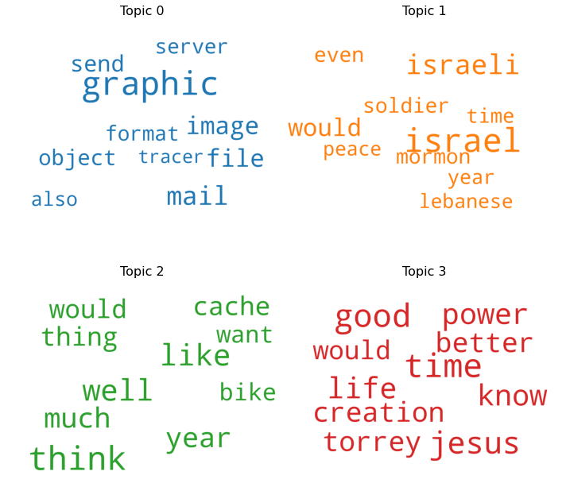
Word Cloud Visualization

Slide 23
Conclusion
⦁ Loading the data
⦁ Clean the Data
Transforming text into something an algorithm can digest it a complicated process. We cannot feed the data as it is, some preprocessing needs to be done. In this task we will be doing some preprocessing to convert our data in a form that we can feed our model with.
⦁ Handling the Stop-words
Text may contain stop words like ‘the’, ‘is’, ‘are’. Stop words can be filtered from the text to be processed. There is no universal list of stop words in nlp research, however the nltk module contains a list of stop words. We will remove these stopwords in this task.
⦁ Lemmatization
⦁ TF-IDF Vectorization
Apart from Count vectorizer an alternative to calculate word frequencies , and by far the most popular method is called TF-IDF. This is an acronym than stands for “Term Frequency – Inverse Document” Frequency which are the components of the resulting scores assigned to each word.
⦁ Topic modelling using LSA
Latent Semantic Analysis, or LSA, is one of the foundational techniques in topic modeling. The core idea is to take a matrix of what we have — documents and terms — and decompose it into a separate document-topic matrix and a topic-term matrix.
⦁ Topic Modelling using Gensim's LDA
One of the drawbacks of LSA is that though it is really fast, its effectiveness in finding good topics is not great. One assumption that LSA makes is that the topics are orthogonal to each other, while Latent Dirichlet Allocation (LDA) relaxes this assumption. Moreover, LDA generalizes the way the documents are generated and this modelling assumption leads to better topics.

